Slide 1
Although I am fierce and deadly,
I am just another soul
And though I look like a danger to you,
Survival has always been my goal.
PANTHERA TIGRIS

Slide 2
I am none other
than our national animal..
PANTHERA TIGRIS

Slide 3

PANTHERA
TIGRIS
GROUP 4
TEAM MEMBERS:
AASTHA JOSHI 20020845001
HARSH TAMBE 20020845010
JOEL PAIS 20020845011
SANDEEP TAKSANDE 20020845030

Slide 4
BALANCE IN THE ECOSYSTEM
Need for Conservation of Tigers
It is a top predator which is at the apex of the food chain and keeps the wildlife in check.
FORESTS
The presence and promise of tigers motivate governments to help protect Asia’s forests.
FRESH WATER
Hundreds of millions of people depend on water from places where tigers roam.
OTHER WILDLIFE
Tiger habitats are home to far more animals than just the iconic big cat.
TRADITIONAL AND INDIGENOUS CULTURES
Protecting tiger landscapes, when done with sensitivity, contributes greatly to preserving endangered cultures and languages.
Source: WWF Website
PANTHERA TIGRIS

Slide 5
KEY STATISTICS
The country has 70% of the world’s tiger population and the latest results of 2018 had shown that India now has an estimated 2967 tigers.
India recorded a 33% increase in number of tigers from 2014 to 2018.
Madhya Pradesh has the highest number of tigers at 526, closely followed by Karnataka (524) and Uttarakhand (442).
Chhattisgarh and Mizoram saw a decline in tiger population and all other states saw an increase.
India's 2018 Tiger Survey has made it to the Guinness Book of World Records for being the world's largest camera trapping wildlife survey (34,858,623 photographs).
Source: India 2018 Tiger Survey
PANTHERA TIGRIS

Slide 6

Threats To Tigers
1. Poaching and wildlife trade
2. Habitat loss and fragmentation
3. Human-tiger conflict
4. Declining prey base
PANTHERA TIGRIS

Slide 7
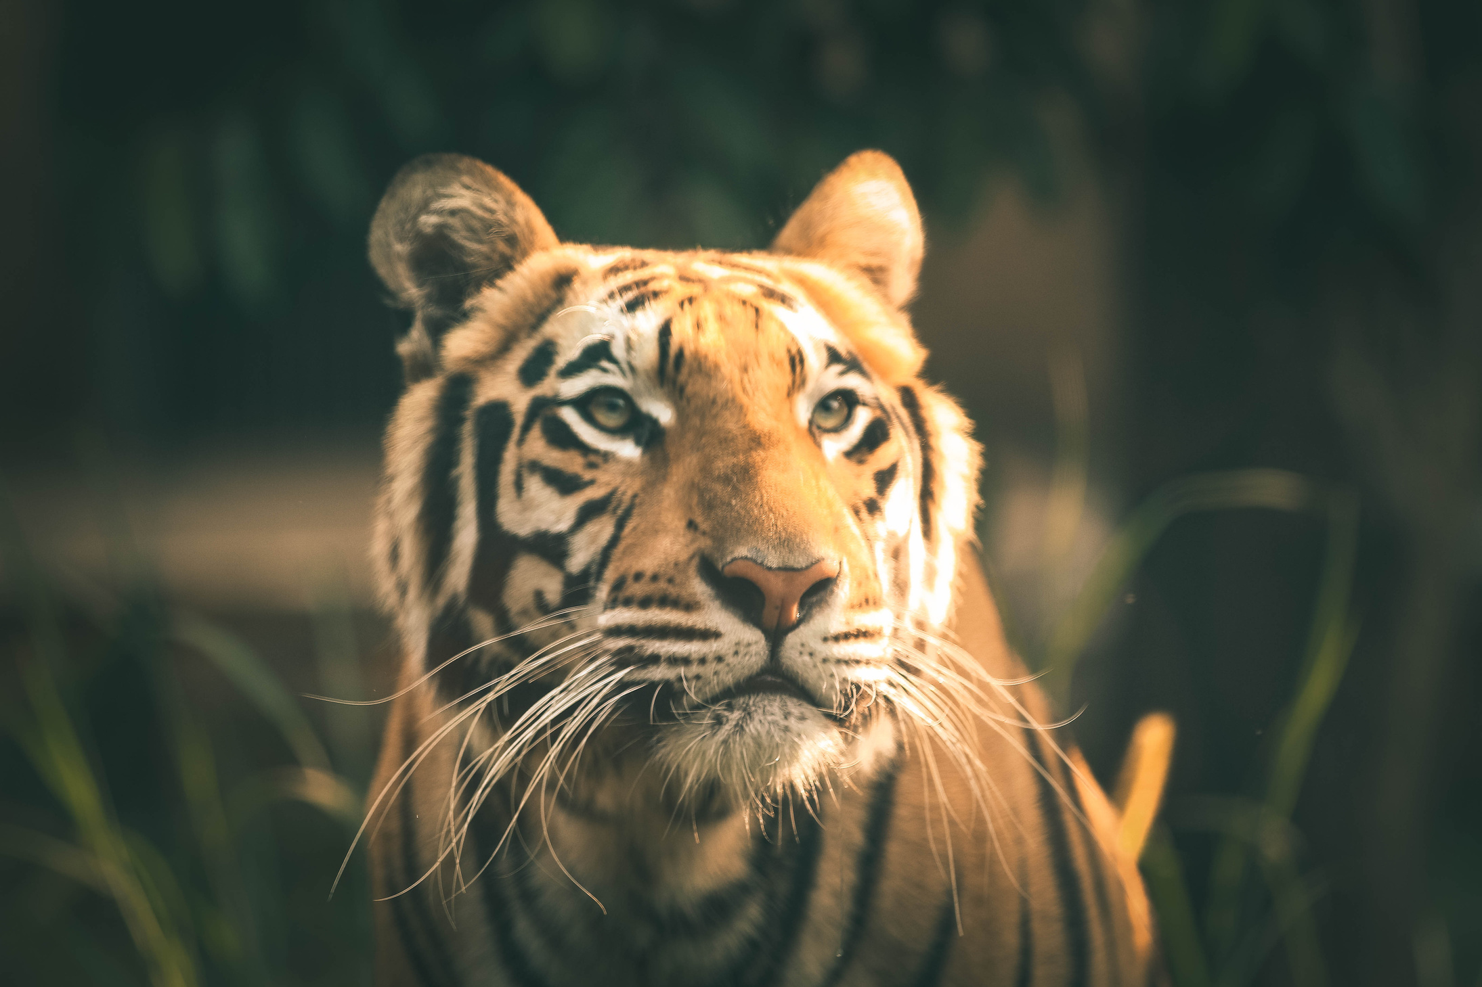
PROJECT TIGER
INITIATIVE BY GOVT. OF INDIA (1973)
POPULATION OF BENGAL TIGER IS MAINTAINED
TIGER PROTECTING FORCE
RESULTED IN INCREASE IN POPULATION
PANTHERA TIGRIS

Slide 8
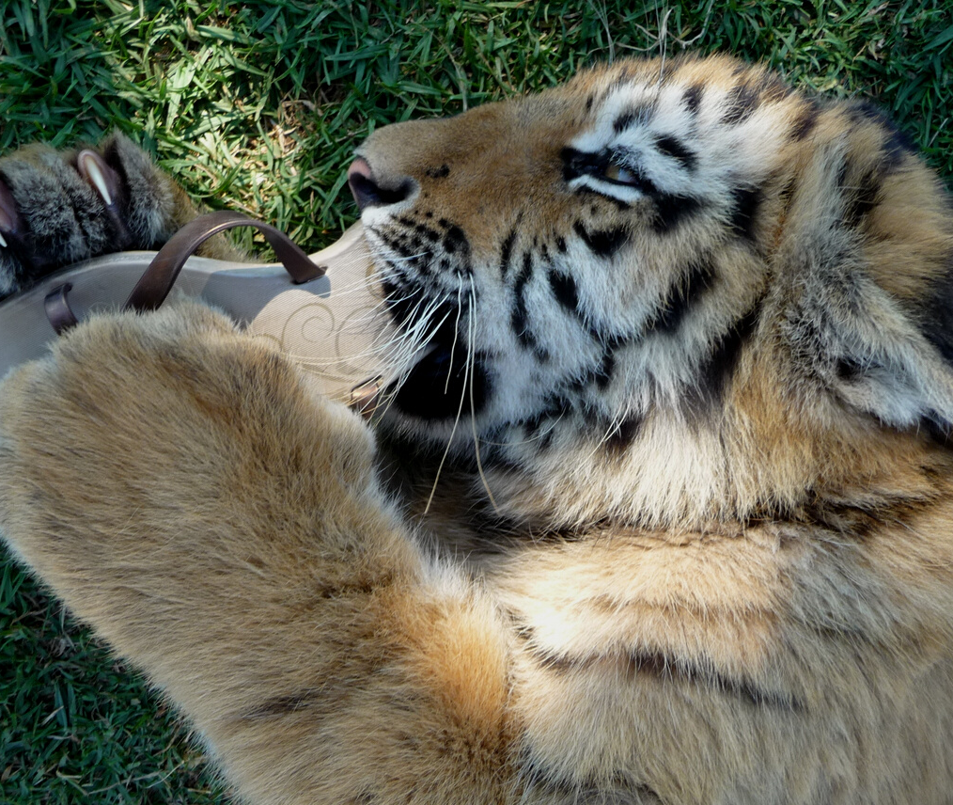
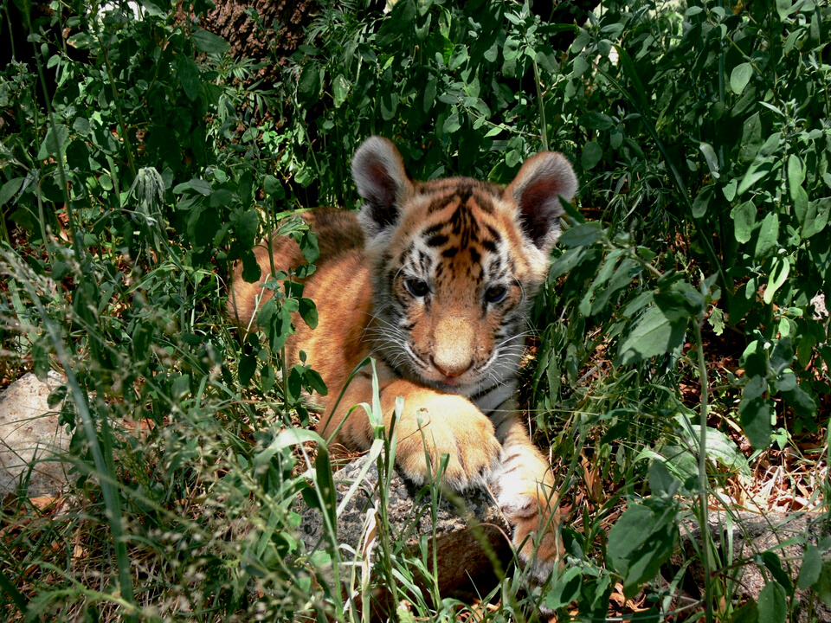
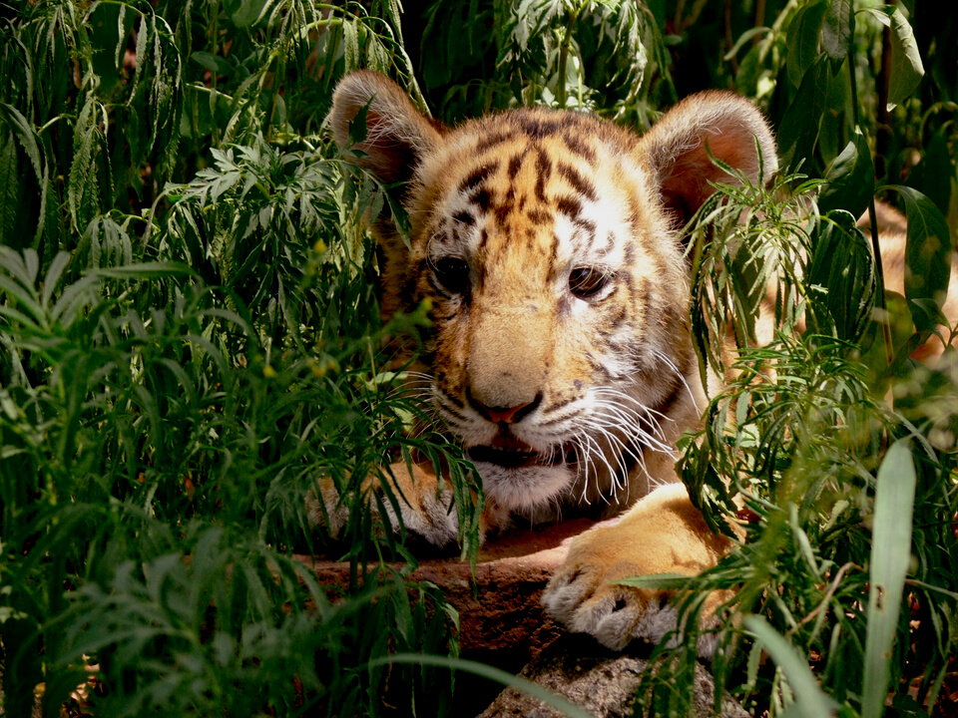
OBJECTIVES OF PROJECT TIGER
1. REDUCTION IS LIMITED.
2. DAMAGES TO BE REPAIRED
3. MAINTAIN POPULATION
PANTHERA TIGRIS

Slide 9
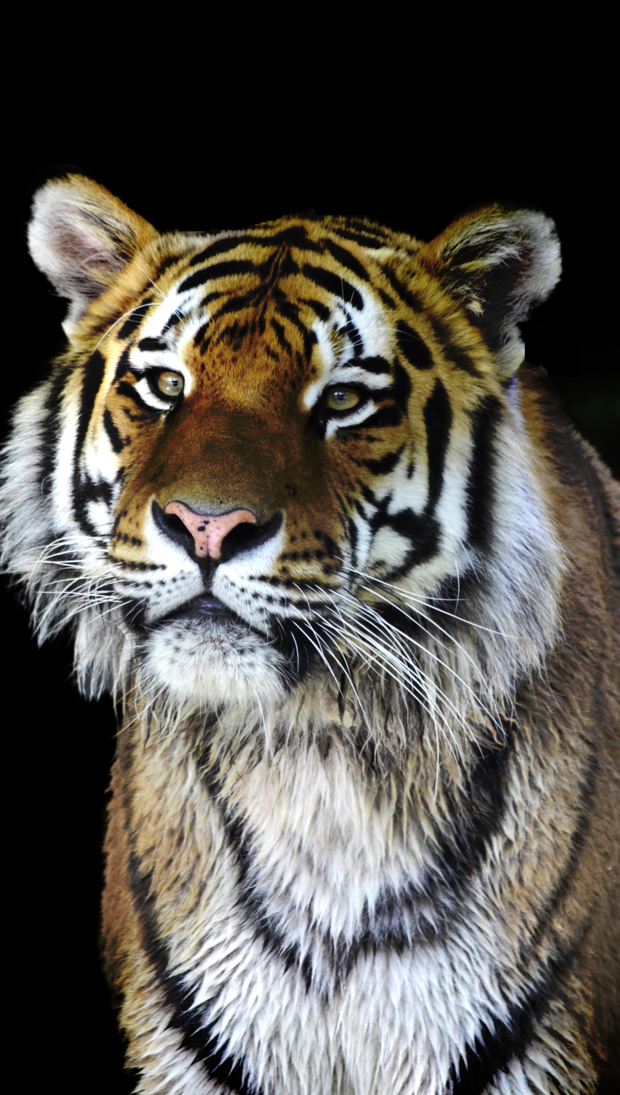
NTCA ACTIVITIES
PROJECT TIGER HABITATS
MONITOR TIGER POPULATION
MITIGATE TIGER HUMAN CONFLICT
RAISE AWARENESS
TACKLE WILDLIFE CRIME
IMPROVE THE LIVELIHOOD OF PEOPLE
PANTHERA TIGRIS

Slide 10

To Conclude:
1. It's not easy to help tigers
2. Encourage those who attempt to do so.
3. Create awareness
PANTHERA TIGRIS

Slide 11
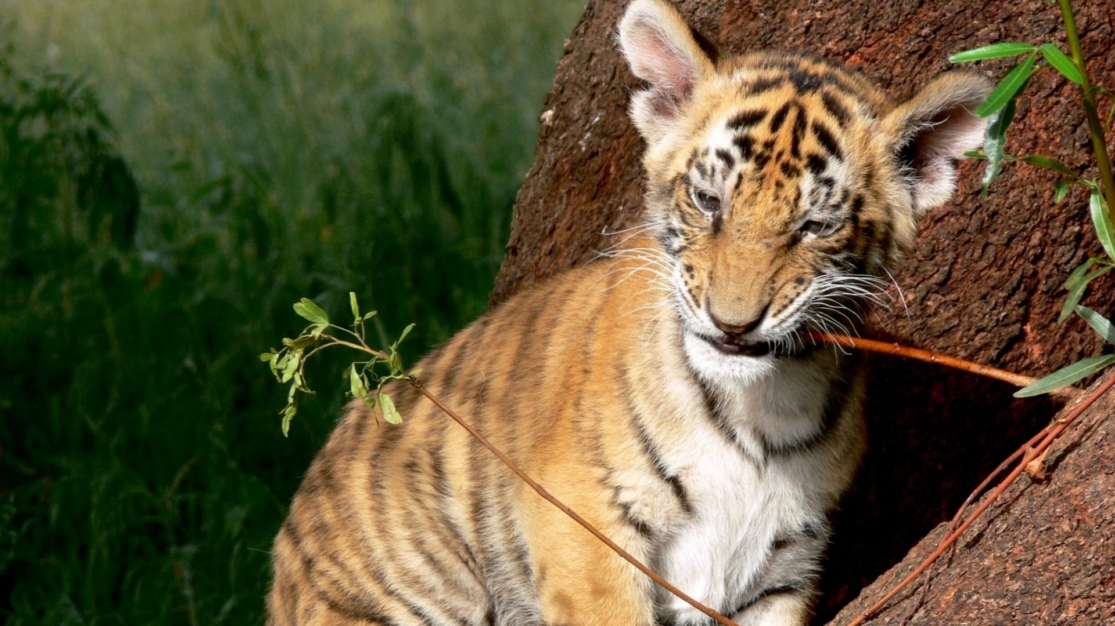
THANK YOU

Slide 12
REFERENCES
https://www.wwfindia.org/
https://blog.nextias.com/indias-tiger-survey-report-2020
https://www.theguardian.com/travel/2013/dec/05/guide-to-indias-tiger-reserves-conservation
https://www.thrillophilia.com/best-tiger-reserves-in-india
https://test.iasbaba.com/posts/importance-of-tiger-conservation-the-big-picture-rstv-ias-upsc/
https://www.aplustopper.com/tiger-conservation-essay/

